Slide 1
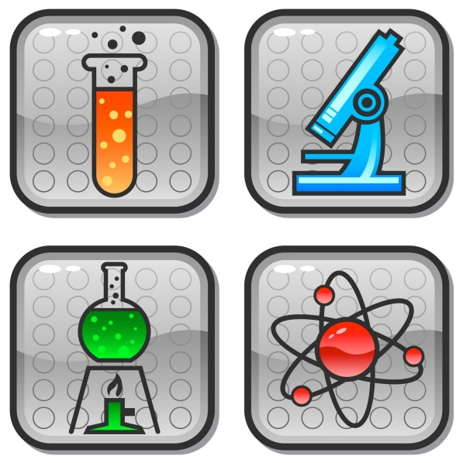
Science and Technology Presentation (20%)

Slide 2
Agenda
Objectives
Steps to take
Topic Selection
Organization
Research
Assessment

Slide 3
Objectives:
To inform, explain, describe, enlighten the audience about a science and technology related topic
To borrow information from literature as supports, using any of these 3 ways: PARAPHRASING - DIRECT QUOTATION – SUMMARY; paraphrasing being the most preferable. (You should use DIRECT QUOTEs only when the information is very well worded, very clear and short - one sentence maybe!!) Whenever you use a source you have to : 1. Orally cite the source 2 .Give reference on the slide (if there is one) 3. Add it to your REFERENCES slide!!
To give a presentation in a well-organized way with a proper introduction, body and conclusion. Notice that you need to use minimum 2 reliable, credible and up-to-date (released in the last 5 years!) sources in the BODY part.
To limit the speech according to the given time constraint: 6 minutes!

Slide 4
Steps to take:
Choose a science and technology related topic and narrow it down : By time, place, person, aspect, number.
Write the topic statement and identify 2 or 3 main
points (parallel items on the same focus).
Get approval for your outline.
Deadline!
Do Research!
Do not forget to Upload your slides to Turnitin
Deadline!

Slide 5
Here is a sample narrowing down process:
Marketing
Marketing Strategies (aspect)
2 Marketing strategies of Nestle Company (number, place)
2 common marketing strategies used in TV commercials by Nestle (aspect/number/place)
(Now you can use it as your topic for the presentation!)

Slide 6

Topic Selection
One Specific Focus
Enlightening. Enjoyable. You should know it well! It might be related to your field of study or hobby.
Feasible concerning the time limit
(6 mnts.)
Researchable

Slide 7
Some sample topic statements: (Notice the single focus in bold!)
Three ways in which digital reading is changing our brains
Two main psychological problems online education can help solve
Two main cognitive differences between human brain and AI
Two main reasons for using animal tissue in human body
Two advantages of 3D password in banking operations
Two benefits of tissue generation for cancer patients (from pg.100)

Slide 8
More sample topic statements:
Two disadvantages of anonymous communication in social media
Two uses of airport/ logistics/ military/ mining/ ... simulators
Three advantages of eye-movement based computer interaction
Two advantages of wireless e-voting for the governments
Three advantages of multitouch technology in higher education
Two main usage areas of online video streaming in business
Two types of Tsunami warning systems used in Japan
Two potential problems of using Personal Flying Suit (100-1)

Slide 9

Topics to avoid (please!!!)
Electric cars
Nucleer Energy
Driverless cars
Car safety tech.s
UAVs / Drones
Maglev trains
Cloud computing
Wi- fi/ Li fi/ LED
Bitcoin
3D Printing
Video/online games
Internet of things
Virtual / augmented reality
Biodiesel
GMOs
Cyber crimes
Robotic surgery
E- books
Cloning
Smart homes/phones
Sorry! They are worn-out and not interesting any more...

Slide 10
Organization patterns:
Classification
Chronology
Effects
Reasons
Advantages OR Disadvantages
Comparison OR Contrast
Problems OR Solutions
Choose only one of them for the presentation please!!
It will be the focus of your topic!!

Slide 11
Faulty outlines(Topics not narrowed down / topics having more than one focus / overlapping main points / Not having only one organizational pattern / main points are not parallel to each other!!)
Google Glass
What
How it works?
Uses
Heat Isolation in Buildings
Advantages for individuals
Advantages for our world

Slide 12
Faulty outlines (too broad topic/ having more than one focus / overlapping main points / not having only one organizational pattern / main points are not parallel to each other!) P.S. Definition or historical background of the topic should be given in the INTRODUCTION before showing the outline please!!
Introduction to Green Energy
The historical roots
The Meaning
The Effects in Turkey

Slide 13
Good outline samples
3 Main Reasons Behind Apple’s Success
Innovation
Experience
Marketing
Advantages of Mobile Devices in Engineering Education
Interactive Classrooms
Interactive Laboratories

Slide 14
Types of Reliable/Academic Sources:
published sources with a reputation for fact-checking and accuracy
found in university, faculty or departmental libraries
specialist journals or newspapers of agreed high repute
government reports
reports by independent commissions or organizations of inquiry.
e.g. (WHO), (UNESCO), (OECD), (NASA)
published theses
the Internet → with reputable author(s), publisher and domain name NO WIKIPEDIA please!!

Slide 15
Sources here are ok
but min 2 in the body
Sources here are ok
but min 2 in the body
Minimum 2 sources

Slide 19
Ground Rules:
There will be deduction of points in case of extreme Reading and Memorization.
If No Turnitin Submission of the slides, No grade!!
Deduction of points if you exceed time limit is:
Over 6’30’’ : - 1
Over 7’ : -2
Over 7’ 30’’ : Instructor stops the presentation and deducts 2 points.

Slide 20
GOOD LUCK
☺

